Slide 1
FP7 ICTSME projekt: „Methodology and supporting toolset advancing embedded systems quality“
Prof. dr .sc. Mirjana Pejić Bach, Ekonomski fakultet Zagreb

Slide 2
Kako je sve počelo?

Slide 3
Koraci u pronalaženju dobrog konzorcija
1. Pronaći konzorcij koji je već bio uspješan u ranijim projektima
2. Identificirati svoje prednosti: znanje iz specifičnog područja, mogućnost organiziranja konferencije, mogućnost organiziranja specijalnog broja časopisa…
3. Javiti se članovima tima
U mom slučaju to je bio konzorcij projekta ICT WEB PROMS

Slide 4
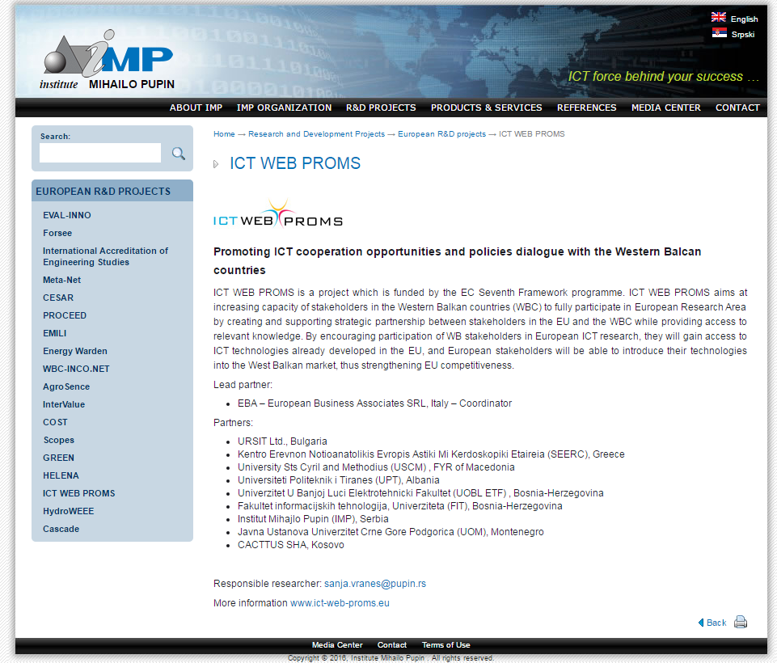

Slide 5
Gdje pronaći dobar konzorcij?
https://danube-inco.net/cooperation_and_networking/projects
http://cordis.europa.eu/projects/home_en.html

Slide 6
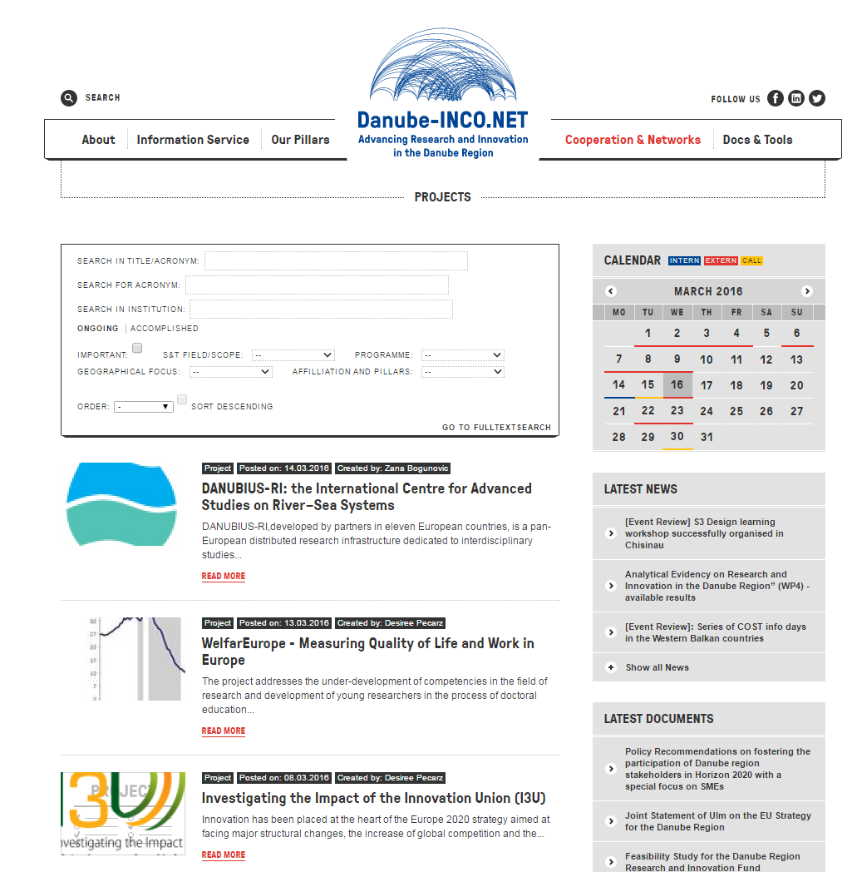

Slide 7
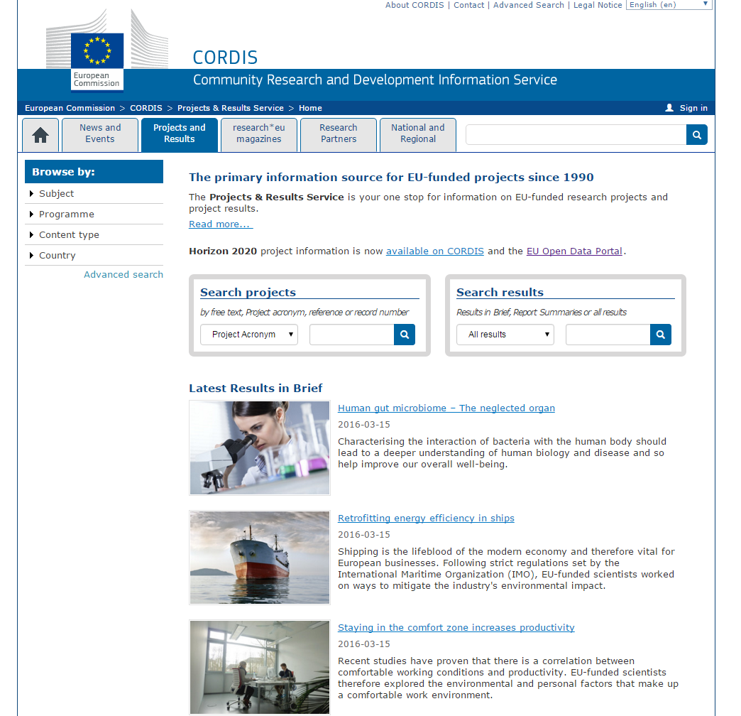

Slide 8
Kako biti uspješan u kontaktiranju?
Sastaviti kratak mail u kojem navedite želju da sudjelujete, kao i svoje prednosti
Pripremite životopis kao privitak e-mail poruci u kojem naglasite područje projekta
Budite uporni…

Slide 9
Što smo radili?

Slide 10
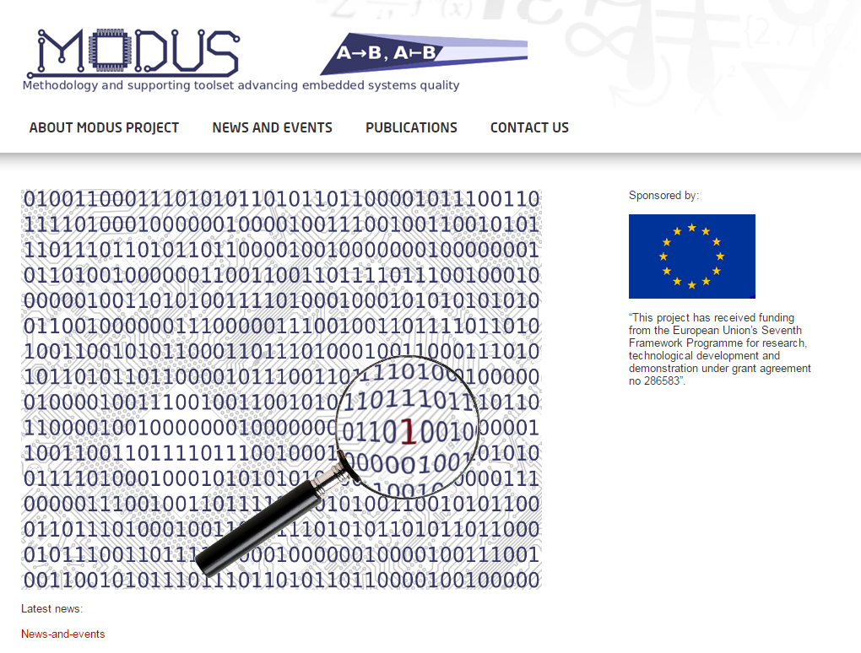
http://www.modus-fp7.eu/

Slide 11
Project description
The MODUS project aims to provide a pragmatic and viable solution that will allow SMEs to substantially improve their positioning in the embedded-systems development market.
The project will develop and validate a set of technical methodologies, as well as an open and customizable toolset, advancing embedded systems quality when using Formal Description Techniques (FDTs), by enabling:
  Model verification by guiding the selection of existing open-source model verification engines, based on the automated analysis of system properties, and producing inputs to be fed into these engines.
  Interfacing with standard simulation platforms for HW/SW co-simulation.
  Software performance-tuning optimization through automated design transformations.
  Customisable source-code generation towards respecting coding standards and conventions.

Slide 12
Project objectives
To develop the MODUS infrastructure for interfacing with existing tools and platforms.
To develop the MODUS Model verificaTion and HaRdware/Software co-sImulAtion tooL (TRIAL) and associated methodology.
To develop the MODUS Performance opTimisation and cUstomisable source-code geNEration tool (TUNE) and associated methodology.
To asses and evaluate the effectiveness of the MODUS methodologies and tools through the realisation of a set of pilots to be administered by the participating SME Associations.
To exploit the MODUS results for the benefit of the participating SME Associations and their SME members.

Slide 13
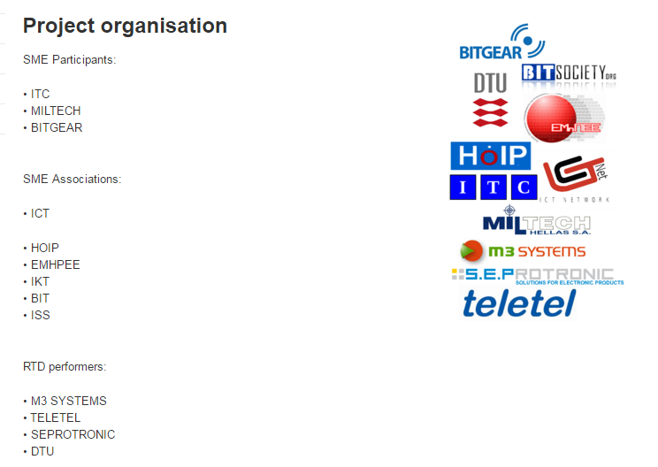
Project organizations

Slide 14

Participating organization from Croatia

Slide 15
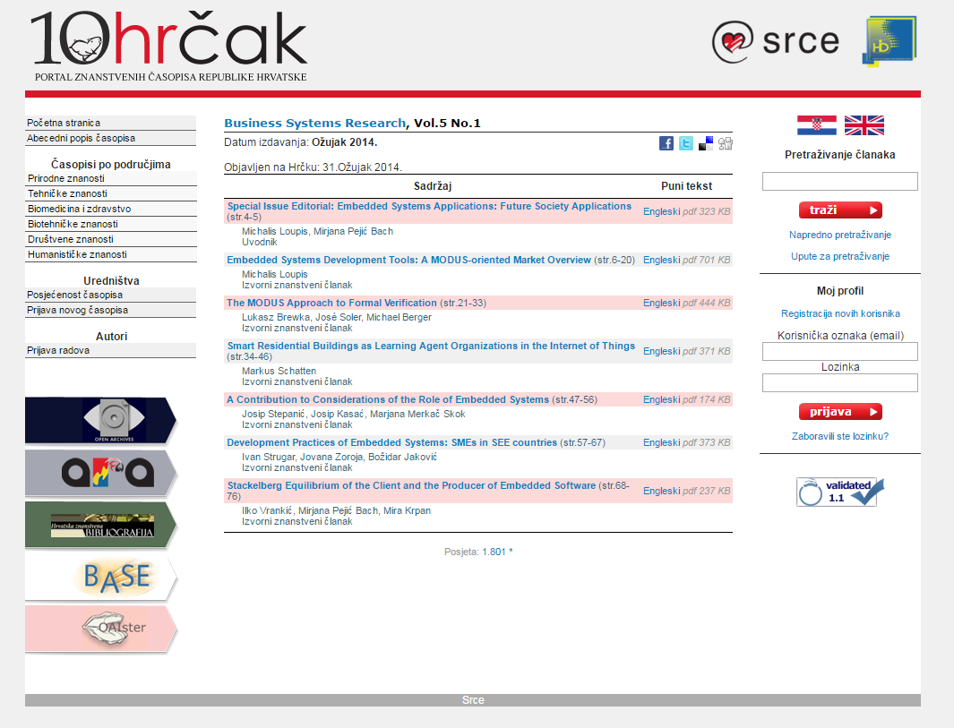
Rezultat projekta – specijalni broj časopisa

Slide 16
Potpora unutar institucije

Slide 17
Uprava fakulteta
Služba za računovodstvo i financije
Ured za međunarodnu razmjenu
Interna potpora (kolege, asistenti)

Slide 18
Kako postati dio projektnog tima?

Slide 19
Opcije kontaktiranja
Osobni kontakti
Direktan kontakt mailom
Upoznavanje na EU networking sastancima
Sudjelovanje na Erasmus projektima
Sudjelovanje na COST projektima
VAŽNO: COST projektima se možete priključiti i nakon što su prihvaćeni – to su otvorene mreže!

Slide 20
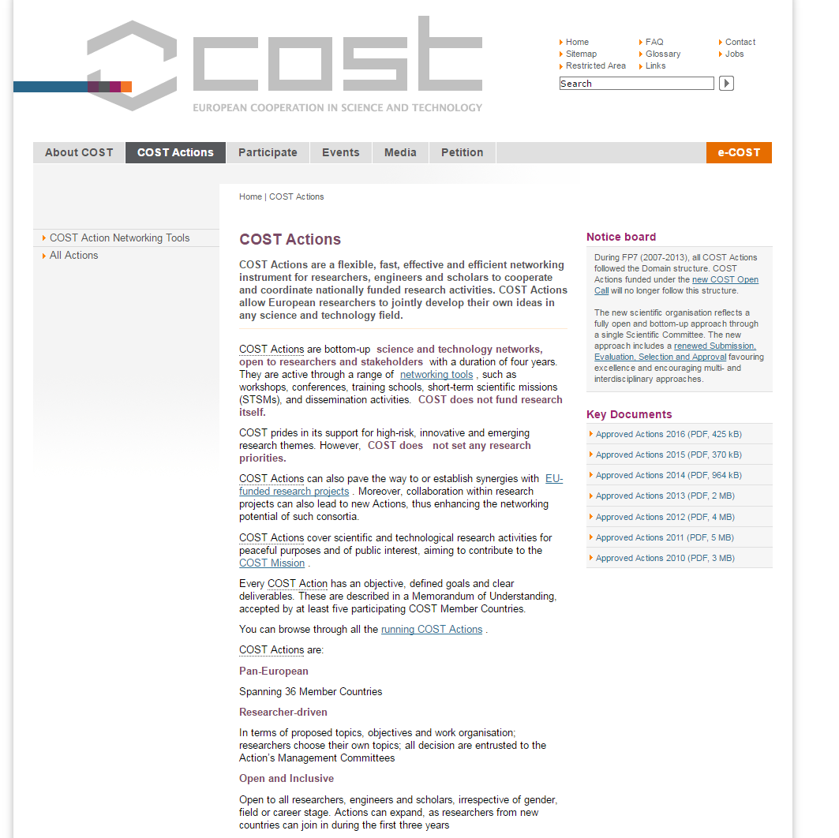
http://www.cost.eu/COST_Actions

Slide 21
Odobrene akcije 2016
CA15207 Professionalisation and Social Impact of European Political Science
CA15212 Citizen Science to promote creativity, scientific literacy, and innovation throughout Europe

Slide 22


Slide 23
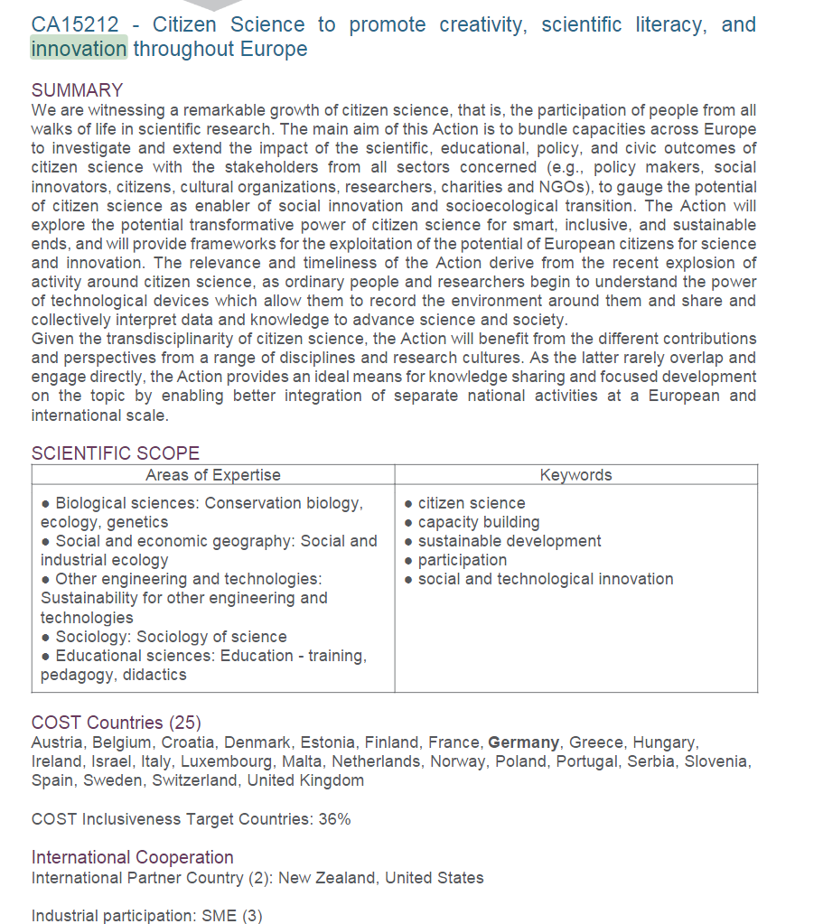

Slide 24
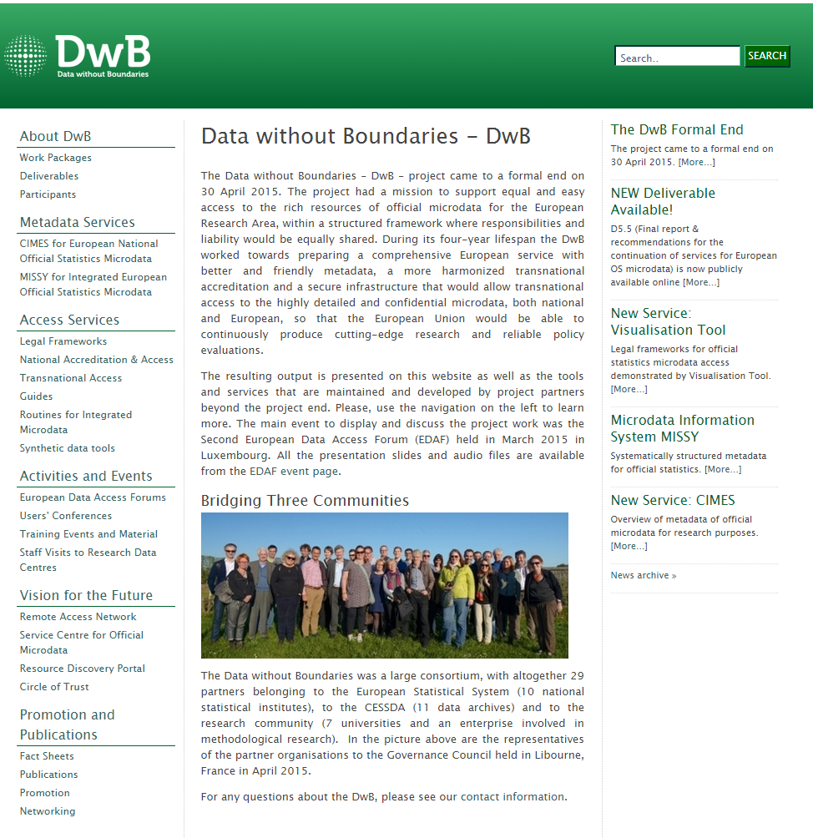
Sudjelovanje o postojećim Horizon 2020 projektima

Slide 25


Slide 26
Kako pripremiti uspješan projekt?

Slide 27
Iskustvo evaluatora?

Slide 28
Hvala na pažnji
Kontakt: mpejic@efzg.hr

